Slide 1


Who Wants to
Be a Millionaire?
Notes:
Lifeline icons on the question slides are hyperlinks which will take you to the lifeline screen. To return to the game, you may right click on the screen, choose Go, Previously Viewed. This should return you to the question slide. Alternatively, left click as usual to return to the game board, then click on the highest number that has been previously selected (in gold to indicate a followed hyperlink).
To utilize the 50:50 option, the moderator may tell the contestant which two options to disregard or, use Control-P to change the mouse arrow to a pen. Draw a line through two incorrect responses, then use Control-A to change the pen back into an arrow and continue with the game.
Clicking on the action button on the phone handset image of the Phone a Friend lifeline slide will hyperlink to the Ask Jeeves web site where the participant may ask for help.

Slide 2



1,000,000
500,000
250,000
125,000
64,000
32,000
16,000
8,000
4,000
2,000
1,000
500
300
200
100

Slide 3


Click to return to question, Cont-P to switch to the pen, cross out two incorrect answers, then Cont-A to switch back to pointer.

Slide 4

Click to return to the question and poll the class

Slide 5

Click on link to Ask Jeeves, or click on this oval to return to question and ask a friend

Slide 6
Who is a legendary pokemon?
A. kyogre
B. chimchar
C. piplup
D. charmander

Slide 7
A. kyogre
Back to Board

Slide 8
Who is a rock pokemon
A. turtwig
B. snorlax
C. geodude
D. pikachu

Slide 9
C. geodude
Back to Board

Slide 10
Who is a fire pokemon
A. piplup
B. chimchar
D. warturle
C.primape

Slide 11
B. chimchar
Back to Board

Slide 12
Who is better
A. palkia
B. pichu
C. charmander
D. pikachu

Slide 13
A. palkia
Back to Board

Slide 14
Who is a grass pokemon
A. palkia
B. entie
C. dealga
D. turtwig

Slide 15
Turtwig
Back to Board

Slide 16

Who is this
A.kygore
B. beedrill
C.turtwig
D. bedof

Slide 17
C. turtwig
Back to Board

Slide 18
what is my fav pokemon
A. milltank
B. darkria
C. palkia
D.chimchar

Slide 19
B. darkria
Back to Board

Slide 20
What is a dragon pokemon
A. chimchar
B.turtwig
C.garchomp
D.pichu
.

Slide 21
C. garchomp
Back to Board

Slide 22
What type is darkria
A. grass
B. fire
C. Electric
D. dark

Slide 23
D. Darkria
Back to Board

Slide 24

Who is this
A.chimchar
B.pikachu
C.lugea
D. darkria

Slide 25
pikachu
Back to Board

Slide 26
Who is a fish pokemon
A. magicarp
B. dialga
C.palkia
D. pikachu

Slide 27
magicarp
Back to Board

Slide 28
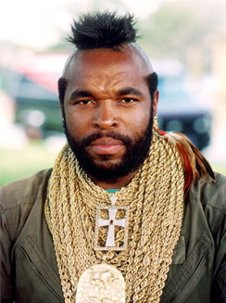
who is this
A.50c
B. mr t
C. eminem
D. a dog

Slide 29
Mr t
Back to Board

Slide 30
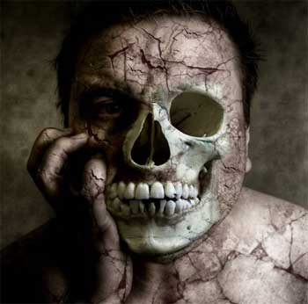
Who is this
A. a cat
B. A dog
C. a zombie
D super zombie

Slide 31
C. A zombie
Back to Board

Slide 32

Who is this
A. darkra
B. Declan
C.mr t
D. bart simpson

Slide 33
D. Bart simpson
Back to Board

Slide 34

Who is this
A. Cartmin
B. mr g
C. bart
D. me

Slide 35
A. Cartmin

Slide 36
Sorry, try again!

Slide 37
Thanks for playing!

